Slide 1
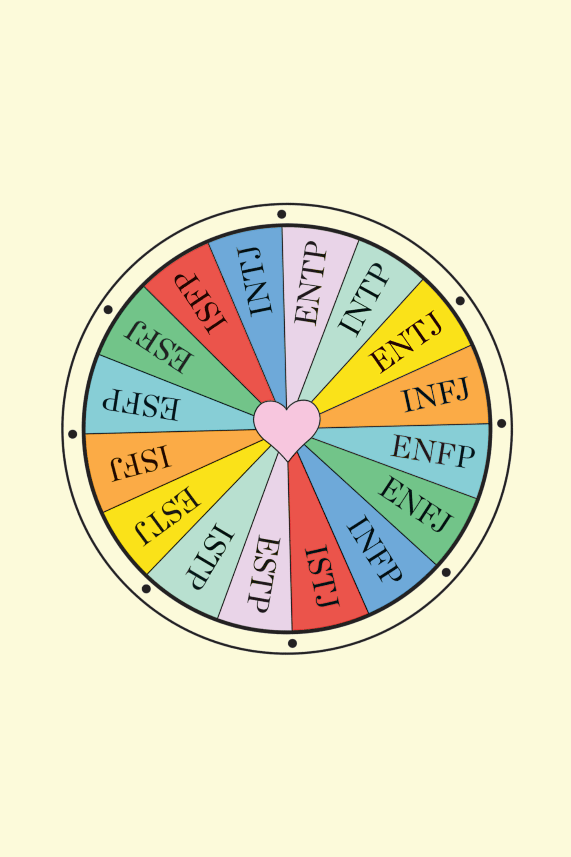
Personality Analysis
Myers-Briggs Type Indicator
Participants
Christopher Guilcapi
Eric Wyluda
Jose Monagas
Katiusca Quijada
Notes:
Showcase Baseline, SVM prototype, projects
Density plots
INTERACTIVE Dashboard
ML (SVM,Random Forest)

Slide 2
01
02
03
INTRODUCTION
Data ETL
Approach
ML
Approach
04
05
Dashboard
Analysis

Slide 3

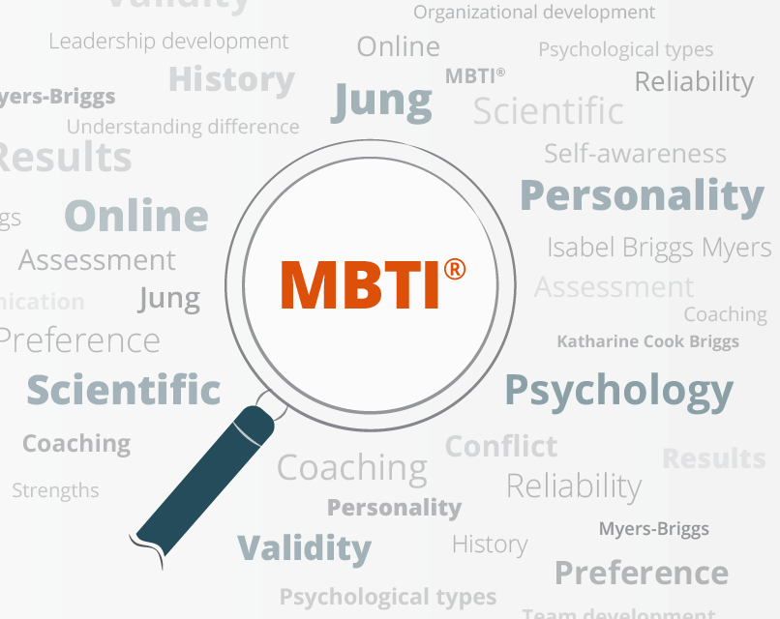
INTRODUCTION TO MYERS-BRIGGS PERSONALITY TYPE PROBLEM SET
Kaggle Twitter dataset of 200 users with the last 50 tweets from each account collected along with their Myers-Briggs Personality Type.
Purpose of Myers-Briggs Type Indicator is to make the theory of psychological types understandable and useful in people's lives. Seemingly random variation in behavior is actually quite consistent, with basic differences in the ways individuals prefer to use their perception and judgment.”

Slide 4
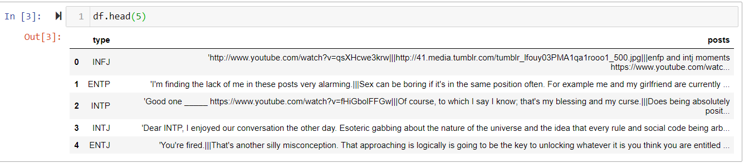
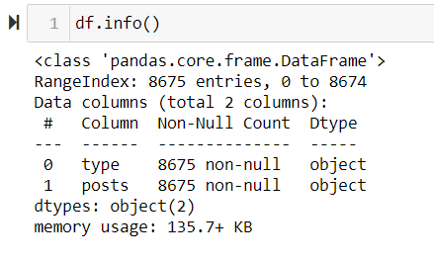
Examine provided data

Slide 5
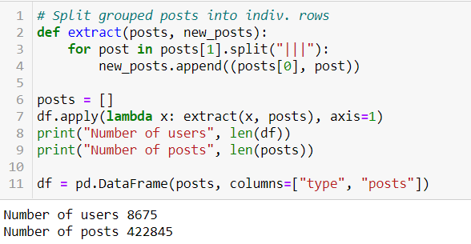
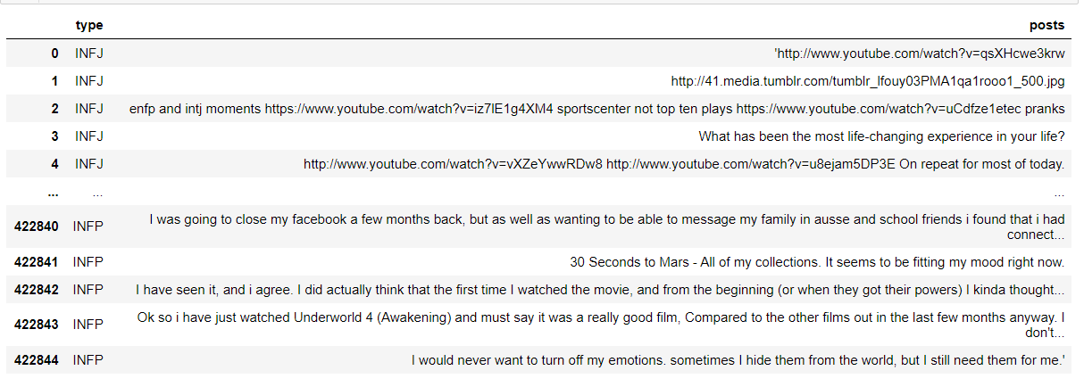
STEP 1: Split posts into rows
Cleaning up the Data Set with functions to have a clean data set for ML and the Dashboard

Slide 6
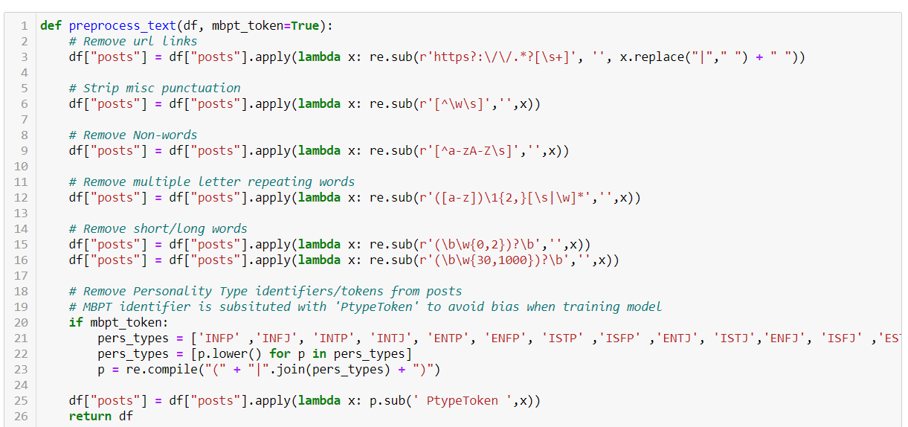
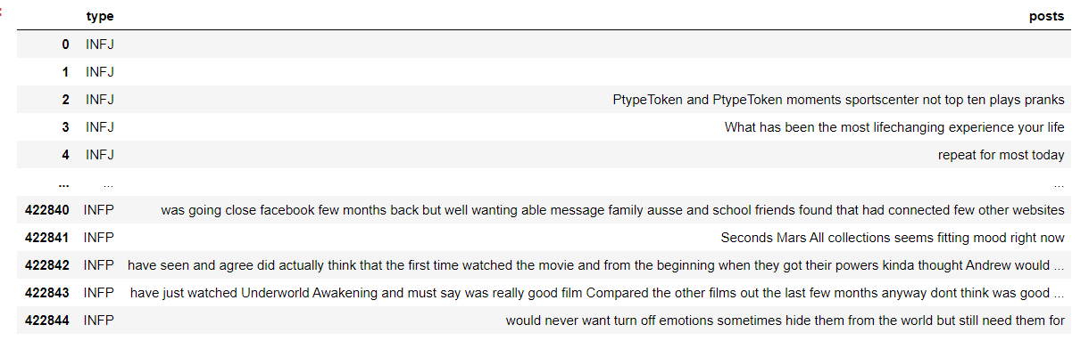
Data cleaning function
Cleaning up the Data Set with functions to have a clean data set for ML and the Dashboard

Slide 7
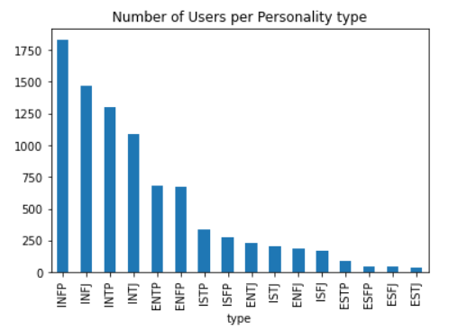
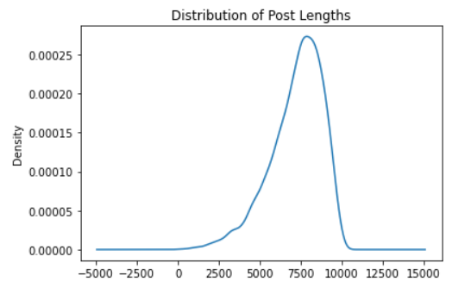
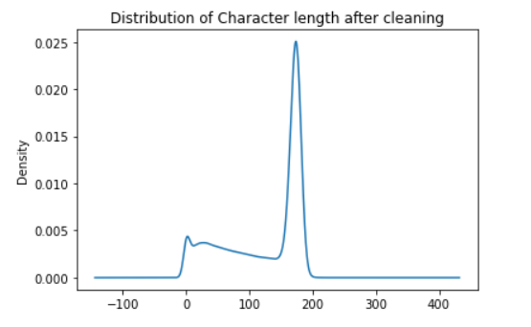
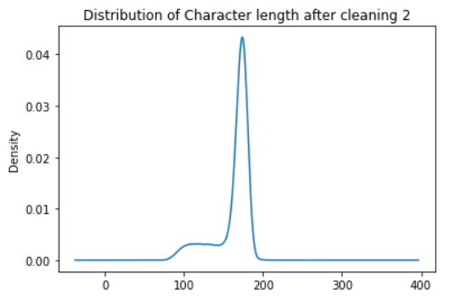
Distribution of data
Cleaning up the Data Set with functions to have a clean data set for ML and the Dashboard

Slide 8
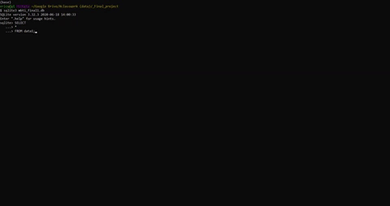
SQLite Database
Cleaning up the Data Set with functions to have a clean data set for ML and the Dashboard

Slide 9
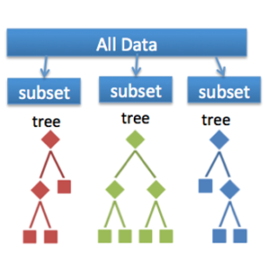
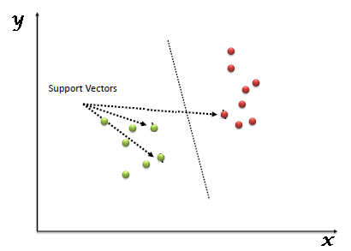
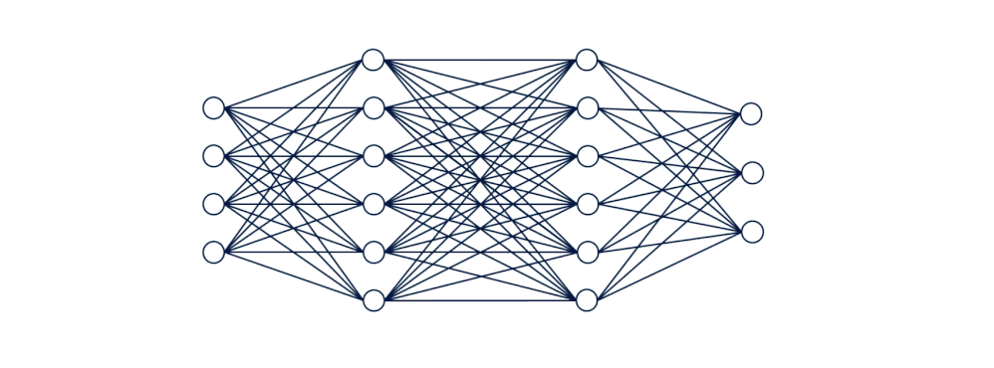
ML APPROACH
Random Forest: Large number of individual decision trees that operate together. Each tree has a class prediction and the one with most votes becomes our model’s prediction.
SVM: Supervised learning models with associated learning algorithms that analyze data for classification.
Neural Network: Multitude of simple processing nodes that are highly interconnected and send data through these network connections to estimate a target variable.

Slide 10
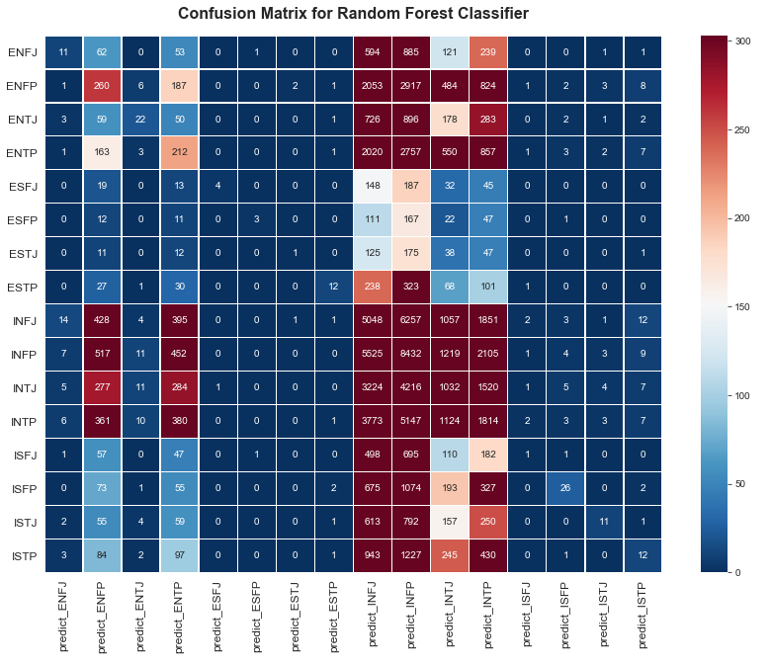
RANDOM FOREST RESULTS
Accuracy: 19.9%
Confusion Matrix: Best performance shown in subset ‘IN’ and ‘EN’ personalities
Conclusion: Slightly lower accuracy than baseline so not suited to predicting classes outside of the ones with the highest frequency.

Slide 11
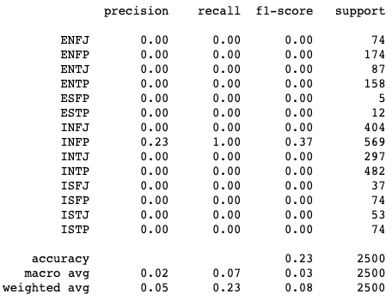
SVM RESULTS
Accuracy: 23%
Confusion Matrix: Best performance shown in subset ‘INFP’ personality
Conclusion: Slightly better accuracy than baseline model at 21%.

Slide 12
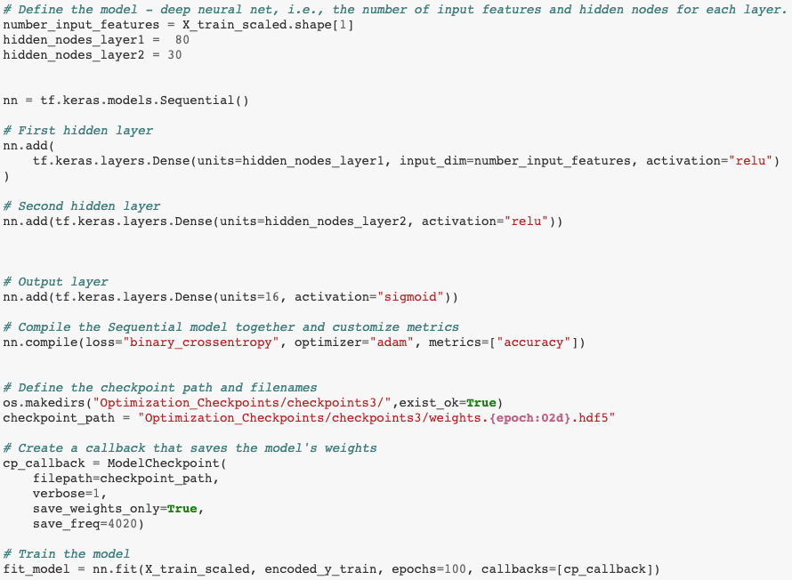
NEURAL NETWORK RESULTS
Accuracy: 27%
Loss: 18.9%
Conclusion: Best accuracy than baseline model at 21%.

Slide 13





DASHBOARD CONNECTION

Slide 14
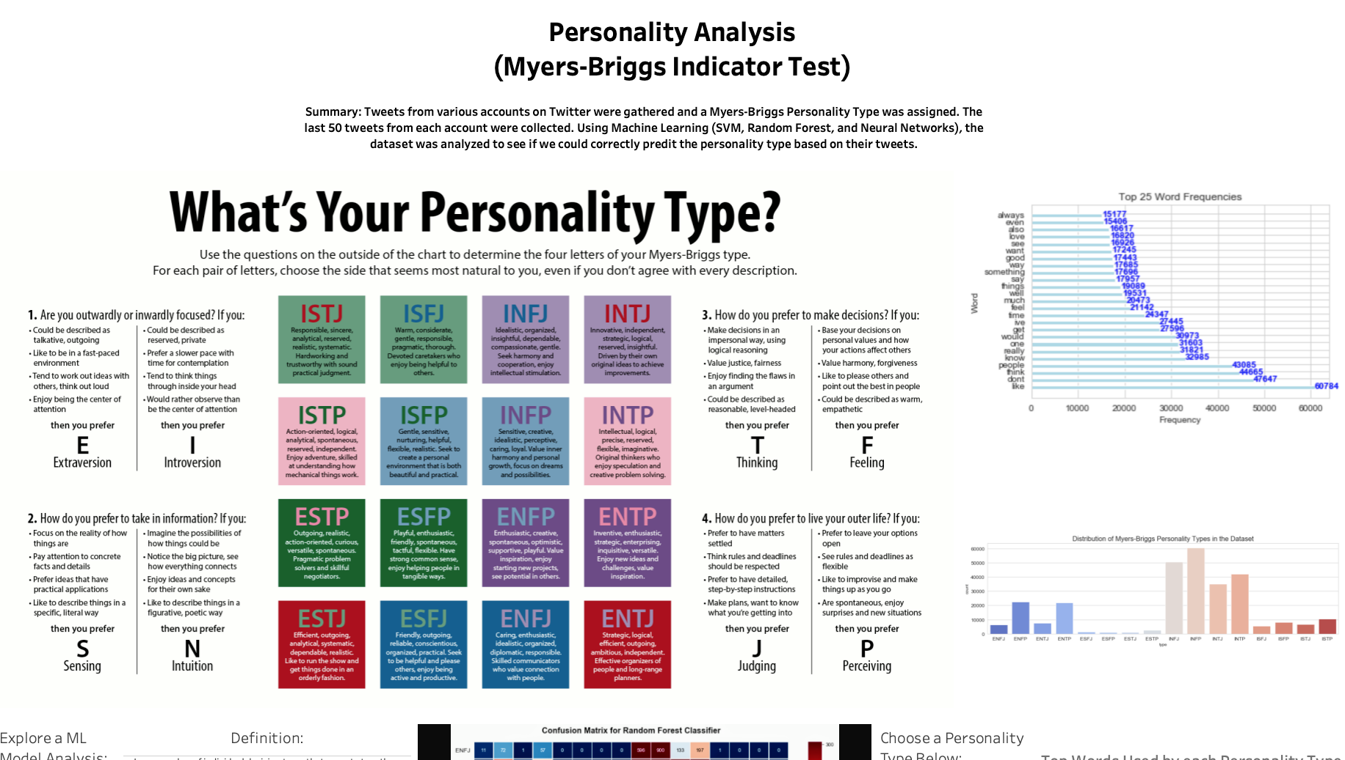
DASHBOARD (Click Here)

Slide 15
ANALYSIS
Let’s take a moment to contemplate the planets

Slide 16
Thanks!
Does anyone have
any questions?
CREDITS: This presentation template was created by Slidesgo, including icons by Flaticon, infographics & images by Freepik and illustrations by Stories

